Slide 1
Segmentation & Classification of Satellite Maps with Deep Learning
Tian (Simon) Yun
Advisor: Dr. Natalia Khuri

Slide 2
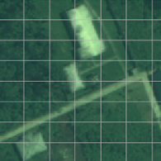
Motivation
New roads & tracks are built, but maps are not always up-to-date. For example, Google Map. How can we make maps real-time?
Satellite maps are updated daily
Aim at developing an application that can be used to detect and segment the map-related objects, such as roads, buildings, etc.
Raw Image
Segmented & Classified

Slide 3
Research Questions
Is it possible to use AI-powered Computer Vision to segment and classify objects in satellite maps?
How do the different parameters in deep learning influence its performance on segmentation and classification?
Notes:
Is this weird, because audience might not know what U-net is?

Slide 4
Specific Aims
Use U-Net, a neural network architecture, to segment and classify the roads in satellite images.
Evaluate the relationship between the following parameters and the performance of U-Net:
Learning Rate
Batch Size

Slide 5
Data
450 3-band (RGB) images Size: 3391(H) x 3349(W) x 3
25 training images annotated with map-related objects
ClassId | ClassType | ClassId | ClassType
1 | Buildings | 6 | Crops
2 | Manmade Structures | 7 | Waterway
3 | Road | 8 | Standing water
4 | Track | 9 | Vehicle large
5 | Trees | 10 | Vehicle small
Defense Science & Technology Laboratory (Dstl) Satellite Imagery Feature Detection

Slide 6
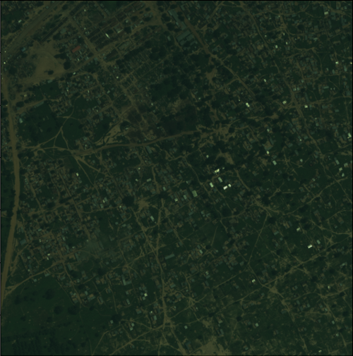
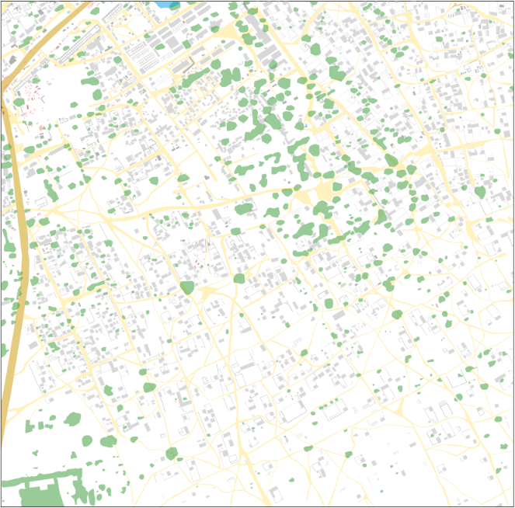
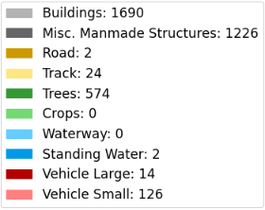
Training Image Example
Raw Image
Annotated Image
Notes:
Fix the legend

Slide 7
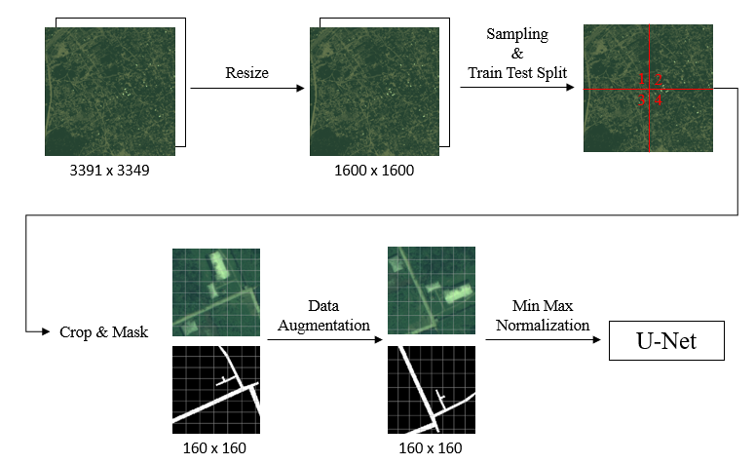
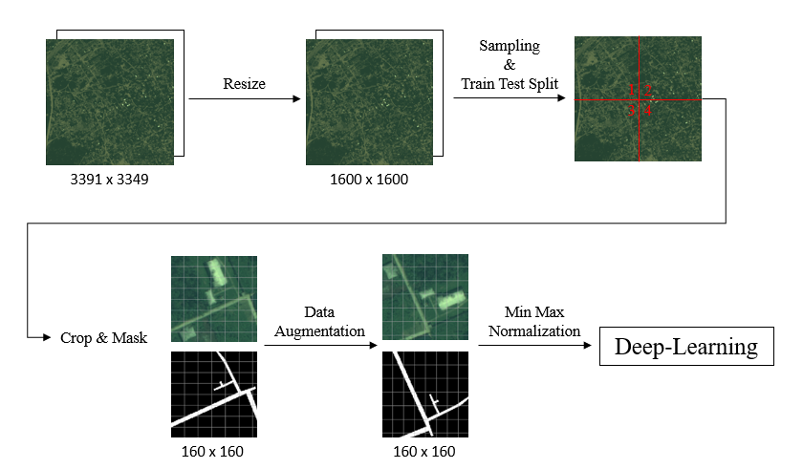
Image Data Preprocessing Pipeline

Slide 8
Resize
3391x3349 raw images will be resized to 1600x1600
Pros
1600x1600 matches the crop’s size 160x160
Shortened training time
Cons
Blurry image

Slide 9
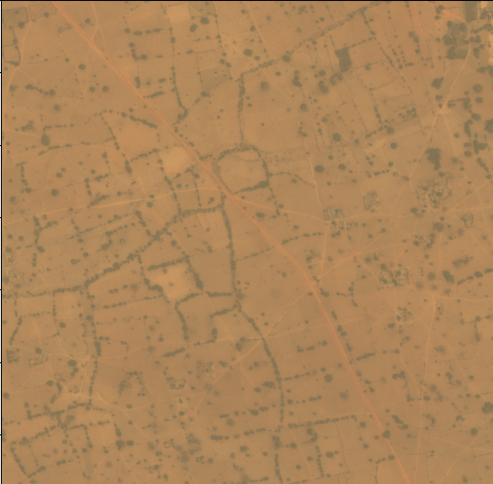
Sampling & Train-Test Split
To make sure the samples scatter among the images, each training image is divided into four parts
Take 6~16 crops from the selected parts of each image
Training size: 857
Validation size: 625
1
2
3
4

Slide 10
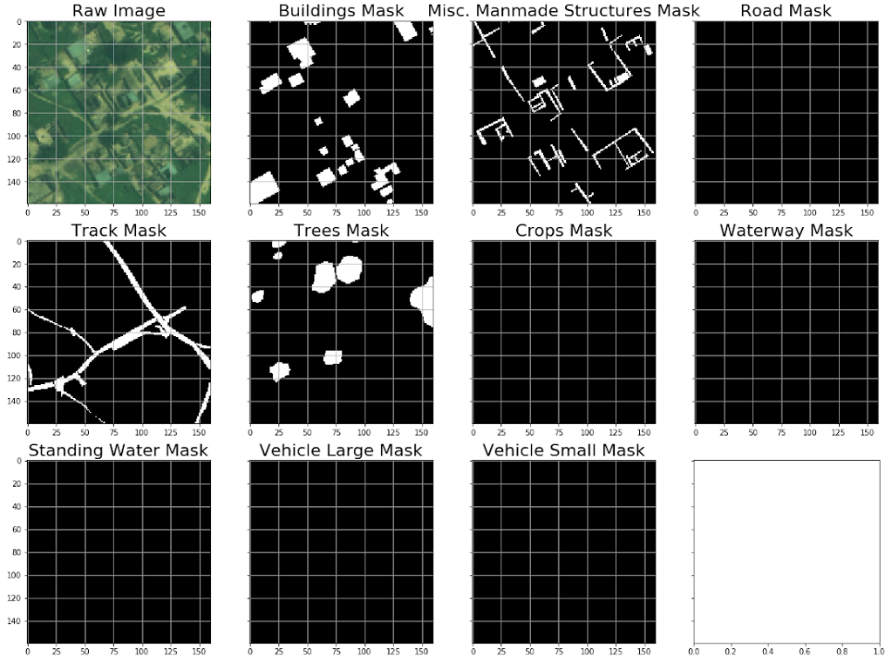
Create Crops & Masks
Create crops of size 160x160
Create masks of each object

Slide 11
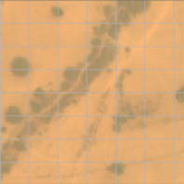
Data Augmentation
Vertical/Horizontal Flip
Might increase the performance of neural network
Horizontal &
Vertical Flip
Raw Image
Horizontal Flip
Vertical Flip

Slide 12
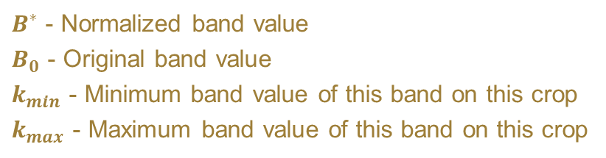

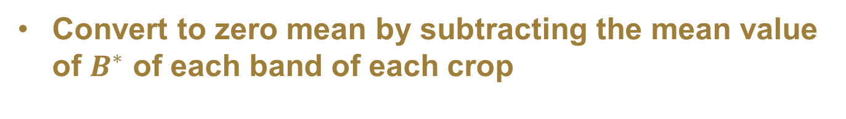
Min-Max Normalization
To remove some effects of brightness or contrast of images, the RGB bands of crops are normalized
$$B^{∗}= \frac{B_{0} − k_{min}}{k_{max} −k_{min}}$$
$B^{∗}$ - Normalized band value
$B_{0}$ - Original band value
$k_{min}$ - Minimum band value of this band on this crop
$k_{max}$ - Maximum band value of this band on this crop
Convert to zero mean by subtracting the mean value of $B^{∗}$ of each band of each crop

Slide 13
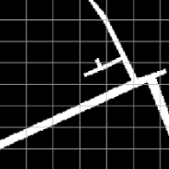
Input & Output of Deep Learning
Input: Processed 160x160 crops and masks
Output: Predicted mask which will highlight where the roads are (i.e. pixel-wise)
Input
Output
Notes:
Input also has masks.

Slide 14
Deep Learning Architecture
I selected U-Net for this project.
Previously, U-Net has been successfully applied to biomedical image segmentation.
U-Net is an architecture of convolutional neural network.
It needs a smaller training set and less time to train, versus the sliding-window convolutional network.

Slide 15
U-Net
Training size: 857 crops (0.91% roads)
Validation size: 625 crops (1.13% roads)

Slide 16
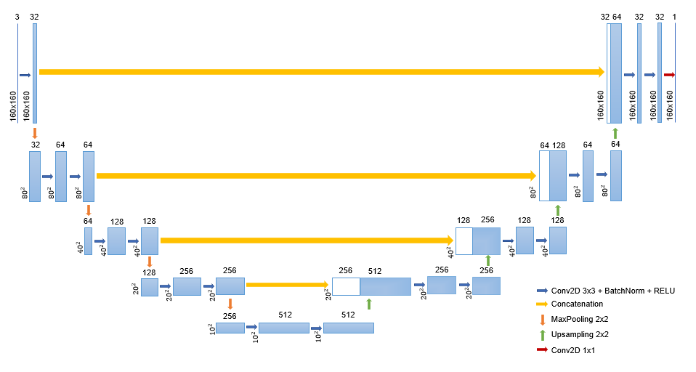
U-Net: Architecture

Slide 17


U-Net: Performance Metric
Performance Metric:
Jaccard Index (Intersection of Union)
$Jaccard= \frac{TP}{TP+FP+FN}= \frac{|A ∩ B|}{|A ∪ B|}$
A
B
$$A ∩B$$
Notes:
Show what is TP, what is FP, what is FN

Slide 18
U-Net: Settings
Parameter | Value
Batch Normalization | True
Convolution Channel | 32
Epochs | 100
Learning Rate | (To be explored)
Batch Size | (To be explored)
Jaccard Loss Function | True

Slide 19
Experiment: Learning Rate
Train with Batch Size = 16
Learning Rate = 7E-05 wins
Training Jaccard Index = 0.469
Validation Jaccard Index = 0.09
Still over-fitting

Slide 20
Experiment: Batch Size
Trained with LR = 7E-05
When batch size is [1, 2, 4, 8], U-Net collapsed.
Batch Size = 64 wins.
Training Jaccard Index = 0.522
Validation Jaccard Index = 0.119
Still over-fitting, but its performance would be improved if I run this longer.

Slide 21
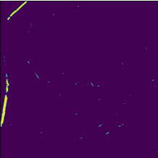
Prediction
Predicted Image
Annotated Image
Notes:
How do people come up with a single value for these metrics?

Slide 22
Prediction
Predicted Image
Raw Image
This is not easy to extract even with human eyes
Notes:
How do people come up with a single value for these metrics?

Slide 23
Conclusion
U-Net is effective at segmentation & classification task, and it does not need large training set.
It is hard to evaluate the relationship between the parameters (learning rate & batch size) and the performance of U-Net.
Current final U-Net has learning rate of 7E-05 and batch size of 64, this U-Net has validation Jaccard Index of 0.119.
This low value might be caused by the imbalance in validation set.

Slide 24
Future Work
Apply U-Net to segment and classify all the 10 map-related objects.
Keep searching for “optimal” hyperparameters, or study and implement hyperparameter optimization methods onto U-Net.
Since we can see that the performance of U-Net increases with larger batch size, we can fit U-Net with larger batch size.
Feed 16-band images into U-Net
Since there is significant over-fitting, so we can
Feed more data into U-Net
More epochs
Search for better values for hyperparameters

Slide 25
Q&A
Q&A

